Slide 1
BLUE ZONE
N Dhatri Sahithi 1602-16-737-010
R Praneela 1602-16-737-029
Hyndavi Vennu 1602-16-737-016

Slide 2
ABSTRACT(CONTD.)
So,this application is used to monitor the amount and type of gases that people are being exposed to.People with health issues can avoid routes that may cause harm to them.
Due to lack of awareness of the growing pollution and it’s effects, lot of people are either ignorant or they unaware. So, live updates of air quality is necessary.
This web app provides status of air quality index and they can be updated about the measures taken to control pollution.

Slide 3
ABSTRACT
Air pollution is most common in large cities, where emissions from different sources are concentrated.
We are creating a web based application to implement a pollution detection and control that will tell the user the amount of pollution in a certain place along with the route so that user can change his route and avoid pollution.
People experience a wide range of health effects from being exposed to Air pollution.

Slide 4
USE CASES
USE CASE 1:By using location tracking from maps,we can tell the user the amount of pollution in a certain place,so that the user can then change his route and avoid pollution.
USE CASE 2: people can be updated about the status of aqi of other countries and organizations that are working towards reducing pollution.
USE CASE 3: We can list the type of gases that people are being exposed to and the effects and preventive methods.

Slide 5
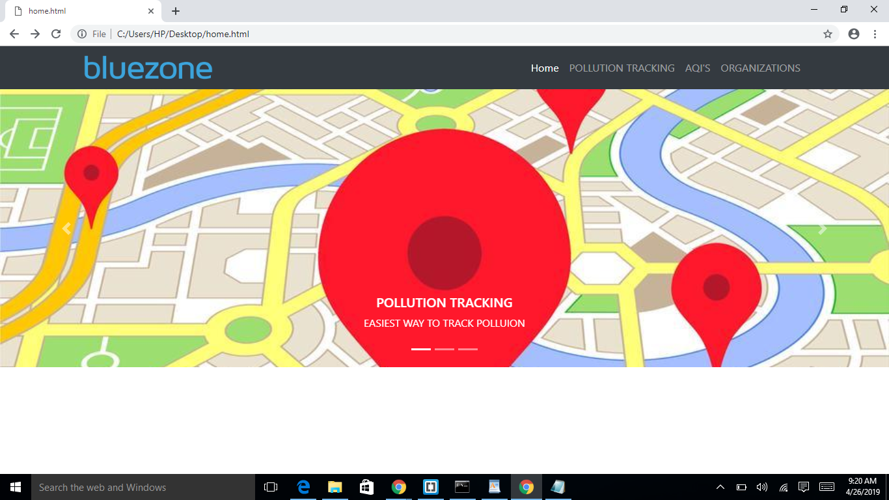
ARCHITECTURE AND TECHNOLOGY USED
FRONT END:
BOOTSTRAP
CSS
HTML

Slide 6
CONTD.
TECHNOLOGIES USED:
DJANGO FRAMEWORK
PYTHON
GOOGLE MAPS JAVASCRIPT API
DIRECTION API (FOR ADDITIONAL FUNCTIONALITY)
MYSQL FOR DATABASE

Slide 7
RESULT
We have compared an existing website called “airquality ontario”
www.airqualityontario.com
It works to protect and improve air quality through legislation.it has a network of few air monitoring stations that collect real time air pollution data and this information is communicated to the public though ontario’s new air quality health inex(aqhi)
on the other hand our app has 4 major features
1.maps markers on highly polluted areas along their route
2.aqi’s of major countries
3.various organizations that support to reduce air pollution
4.air composition ,health effects and preventive measures

Slide 8
CONCLUSIONS AND FUTURE WORK
1.live tracking
2.storing and retrieving dynamic data using databases

